Slide 1
SAR – Synthetic Aperture Radar
First – Walk on Real Radar Systems
And the Specifications of SAR and types
Queries , TBD and Discussions
Working on! Current process!!

Slide 2
Walk on - - Real aperture Radar or Radar Systems
Outline – Polarization
HH,HV, VV, VH
HH- good in Penetration mostly the Cities
VV – good for the sensitivity of Water bodies
HV and VH have good sensitivity over the plains and forest
(NISAR uses all Three to get a better Image quality in SAR)

Slide 3
Resolution
2 types
Range and Azimuth resolution
Range resolution depends on the Pulse Width .
Two parameters SRR and GRR – slant range and Ground Range\
Maintaining the Far Range

Slide 4
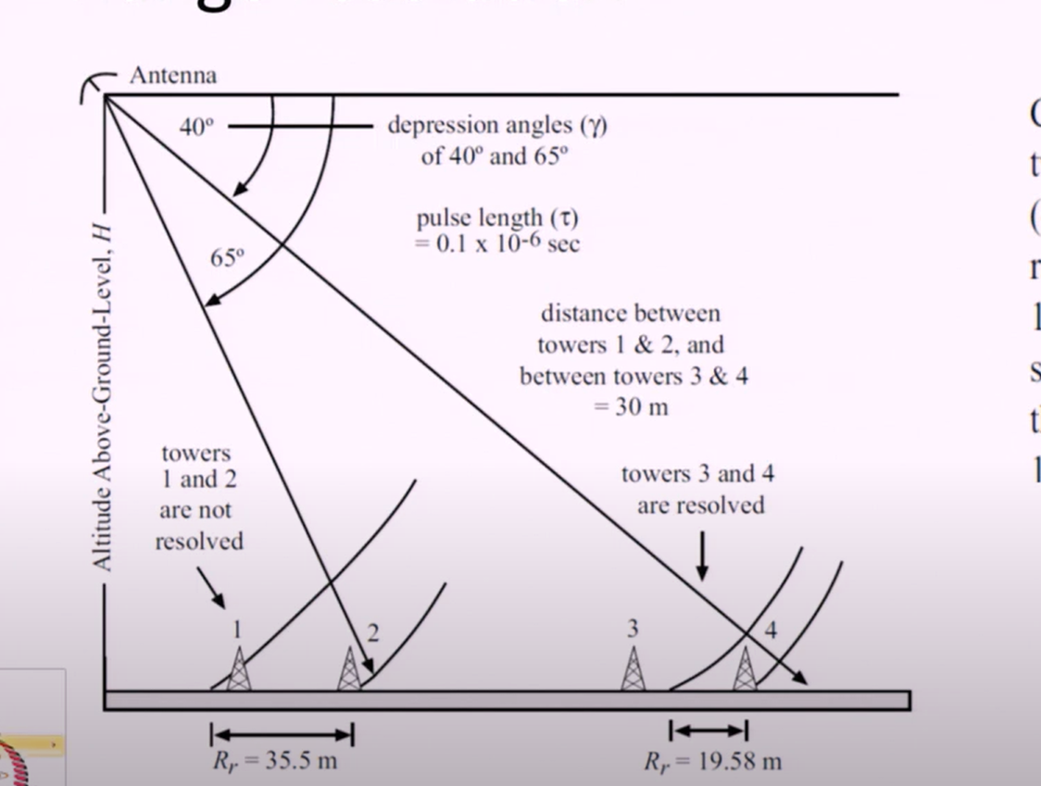
Maintaining the Far range for the Range Resolution

Slide 5
Trade off
SRR = Time of Transmission x C
Time of Transmission Proportional pulse width Proportional Power Transmitted
So, we need to fix the resolution range ! And go through the Tradeoff

Slide 6
Azimuth Resolution
Narrower the Beamwidth == More the Resolution
Length of the increase more the Precise the Data from SAR
Nearer the Object – Nearer the field more the Resolution

Slide 7
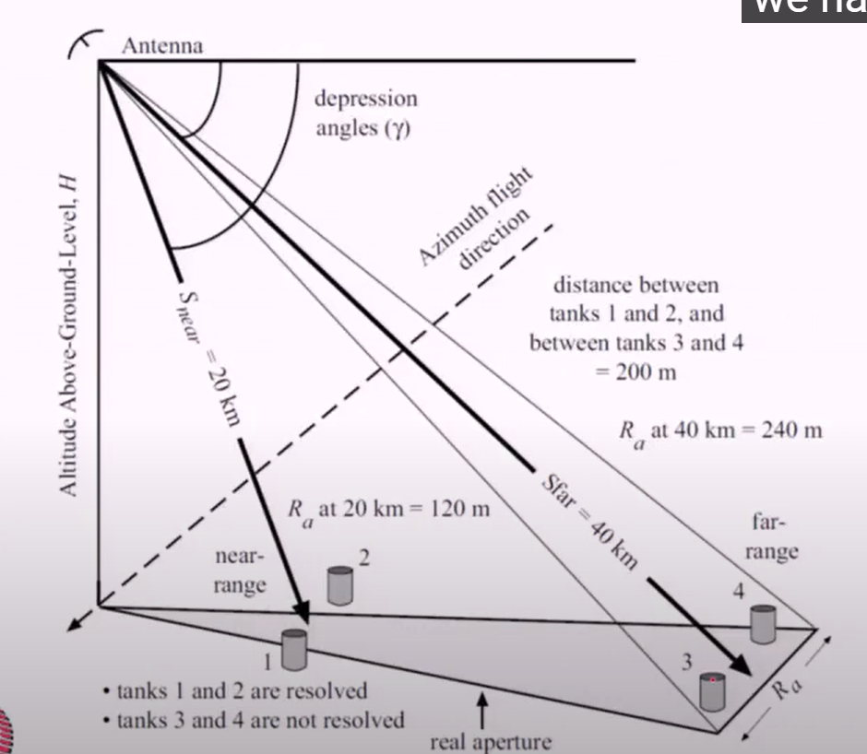
Nearer the Field

Slide 8
Trade off
Antenna Length and the Resolution and the Cover area- Aperture area
More the Length of Antenna more the Resolution!!
And the Wavelength is Lesser more the Resolution!!
Distance between the Satellite and the Earth surface is higher lesser the resolution- Azimuth Resolution
So we are moving to SAR

Slide 9
@ Consideration, the Doppler Shift
Whenever the movement of the source or the object sensed is moving the Frequency will change
For know we consider the motion of the structure moving in earth in a mountain then the wave we send , will return at Higher Frequency , when it is moving the thing is vice versa , will return the lower frequency

Slide 10
SAR
Like the RADAR system – data from many points like data from the moving satellite in Azimuth Direction
Many points with an Effective DSP and the Doppler effect matching can produce the Image with Best Resolution.
Theoretically it seemed to be increase in size of antenna , That we are acquiring data from the different points in Azimuth direction

Slide 11
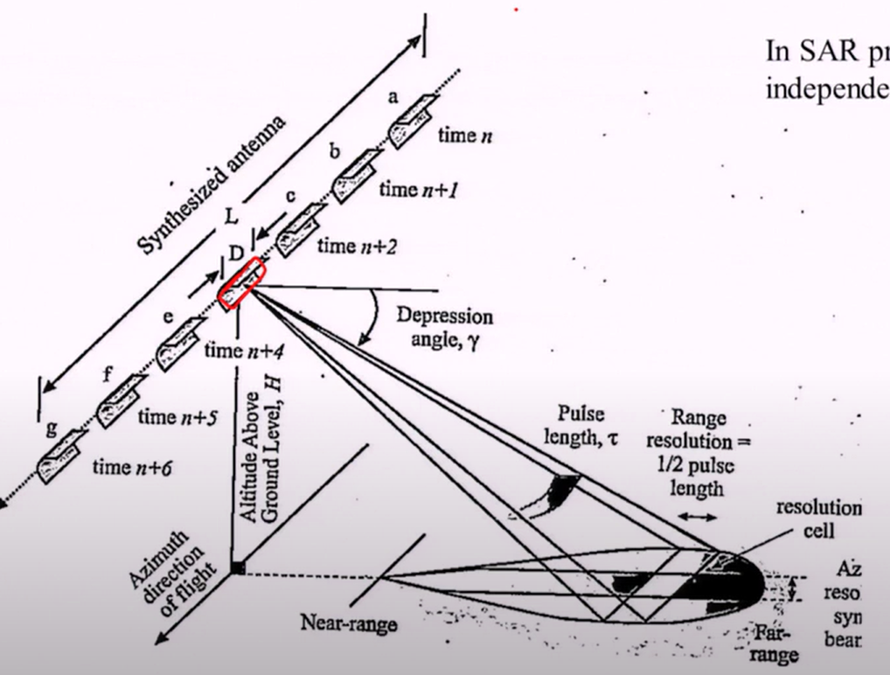
SAR model

Slide 12
Types of SAR (literature and Done by other)
SCAN SAR – achieved 40-40 range and azimuth in swath of 500km
SPOTLIGHT SAR- achieved 1m – 3 m in swath of 25km,4-2 in 80km
STRIPMAP SAR- achieved 3-1 m in swath of 35 km
TOP SAR- achieved 43-8 m in swath of 400 km

Slide 13
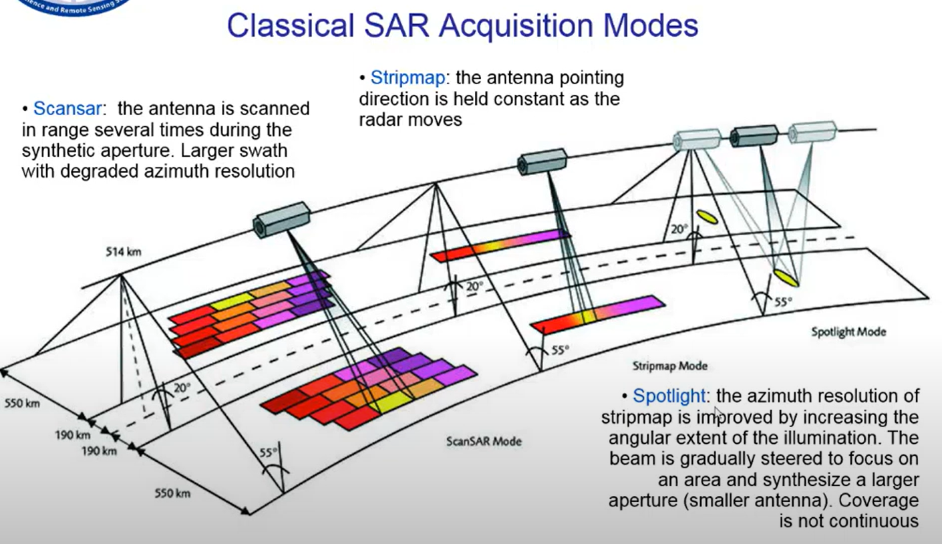

Slide 14
Queries !! and TBD and Discussions
What is our Resolution range and TBD the type of SAR need be designed!
Pulse width and signal frequency!- application
Power consumed by the Spotlight Sar is much higher the Scan SAR, Proposal docs say the Power for Processing is 70 w which is achieved for 20W to 30W SCAN SAR , other SAR cannot operate in this Range!
The Antenna length element is a Concern in the Dimensions of the Satellite!
Next detailed level designs

Slide 15
References:
A tutorial on SAR 2013 : https://elib.dlr.de/82313/1/SAR-Tutorial-March-2013.pdf
SAR terminologies : https://sentinels.copernicus.eu/web/sentinel/user-guides/sentinel-1-sar/definitions
SAR theory : https://www.geo.uzh.ch/~fpaul/sar_theory.html
Remote Sensing IITB – Prof.R.Eswar theory notes

